Slide 1

WordPress at Scale
go.epfl.ch/ wpatscale
Dominique Quatravaux
EPFL ISAS-FSD
FOSDEM’2026

Slide 2
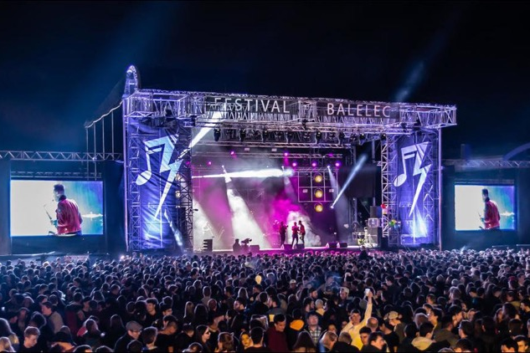
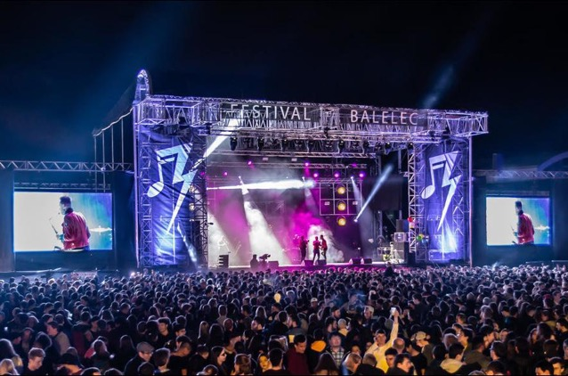
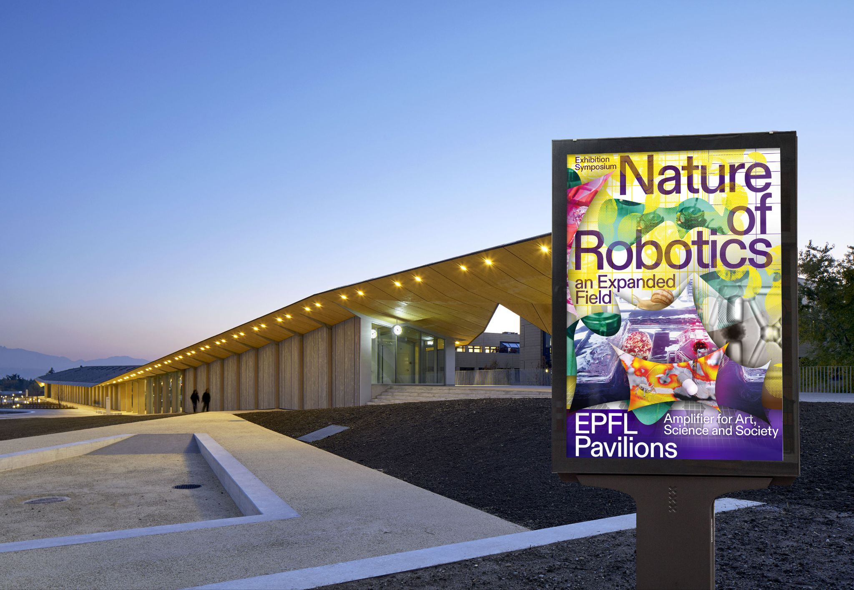
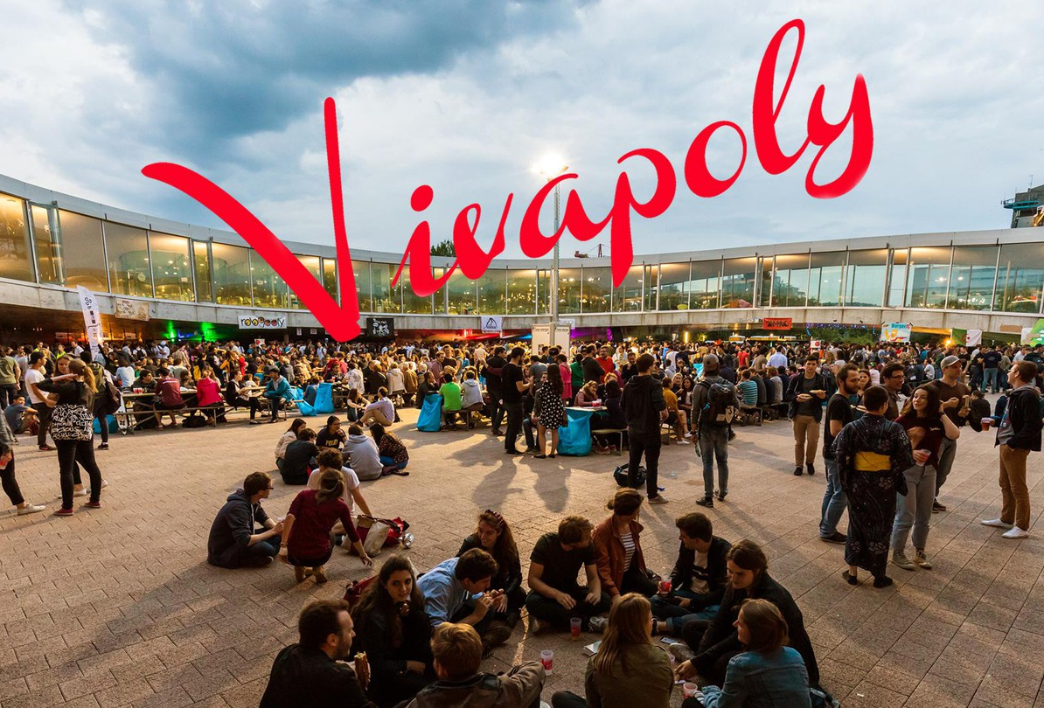
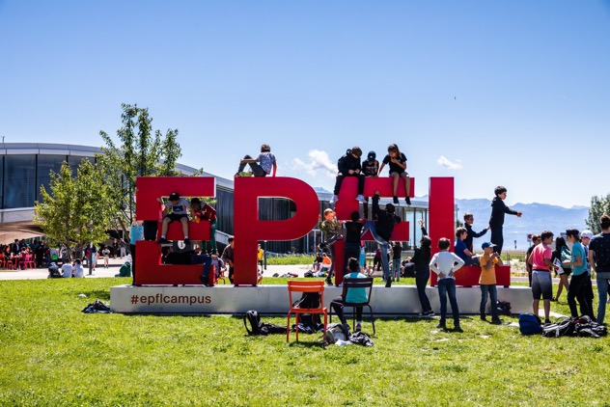
EPFL is
… BIG
14’012 students
372 academic staff
6’530 employees
130 home countries
… We have datacenters!
(… with VMs and NFS)
Our team: 8 employees, 5 interns
… for 26 apps (not just WordPress)
Notes:
This is an on-premise use case. I know next to nothing about Azure, Amazon et al.

Slide 3
> Serving at Scale
Operating at scale
Developing at scale*
Kubernetes, containers, pods
php-fpm, nginx
Off-premise cache 😇

Slide 4


We’ll need… 865 WordPresses.
… 679 of which live under the same DNS domain, www.epfl.ch
  Homepage
  www.epfl.ch/labs/foolab (400×)
  www.epfl.ch/campus/associations/bar
  (60×)
  …
inside.epfl.ch/department-baz (100×)
quuxconf2026.epfl.ch
…
Notes:
Access and resource control less of a headache

Slide 5
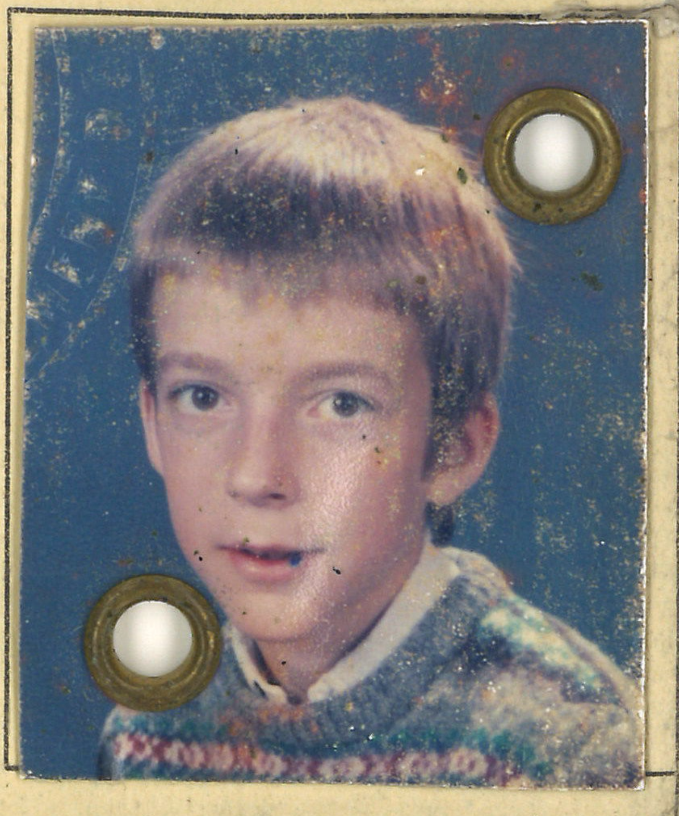
Attempt #1 (~2019) =
WordPress of the 2000s
Designed and operated as a general-purpose LAMP hosting
Tenant uploads
  WordPress (or whatever)
  Theme(s)
  Plug-in(s)
We kind of didn’t know any
better back then.
Notes:
That was me, circa 1988.

Slide 6
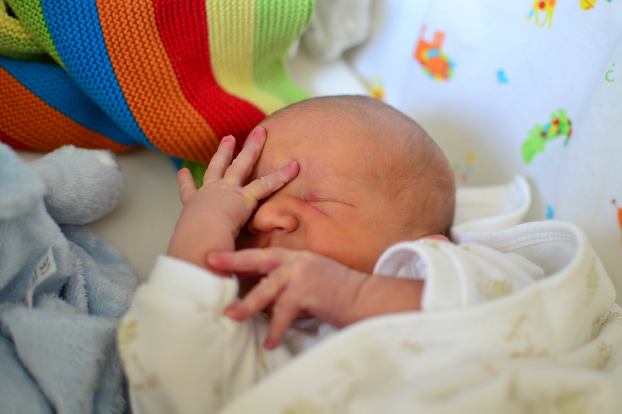
… Not really at scale.
Apache?
  1 request = 1 thread
  Always costs full price (in RAM, threads)
PHP over NFS?
  WordPress includes ~1000 PHP files as part of its hello-world code flow
  Latency is at least 1000× the RTT to your filer
    Cache?
    … Doesn’t help — revalidates with stat(2)

Slide 7
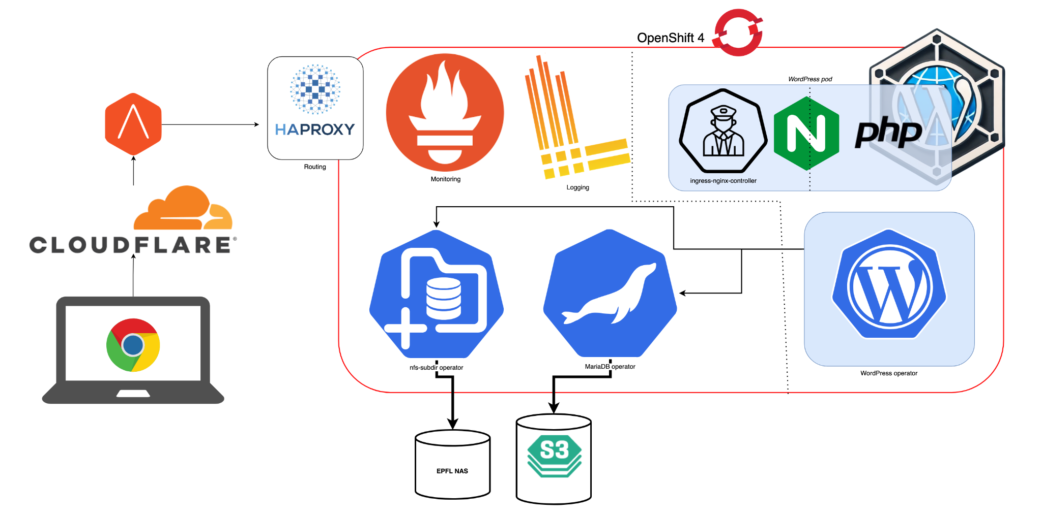
In 2025: do it again, do it right
Notes:
Click image link → Fichier → Publier → Mode présentation… (💡 requires access, speaking French)

Slide 8
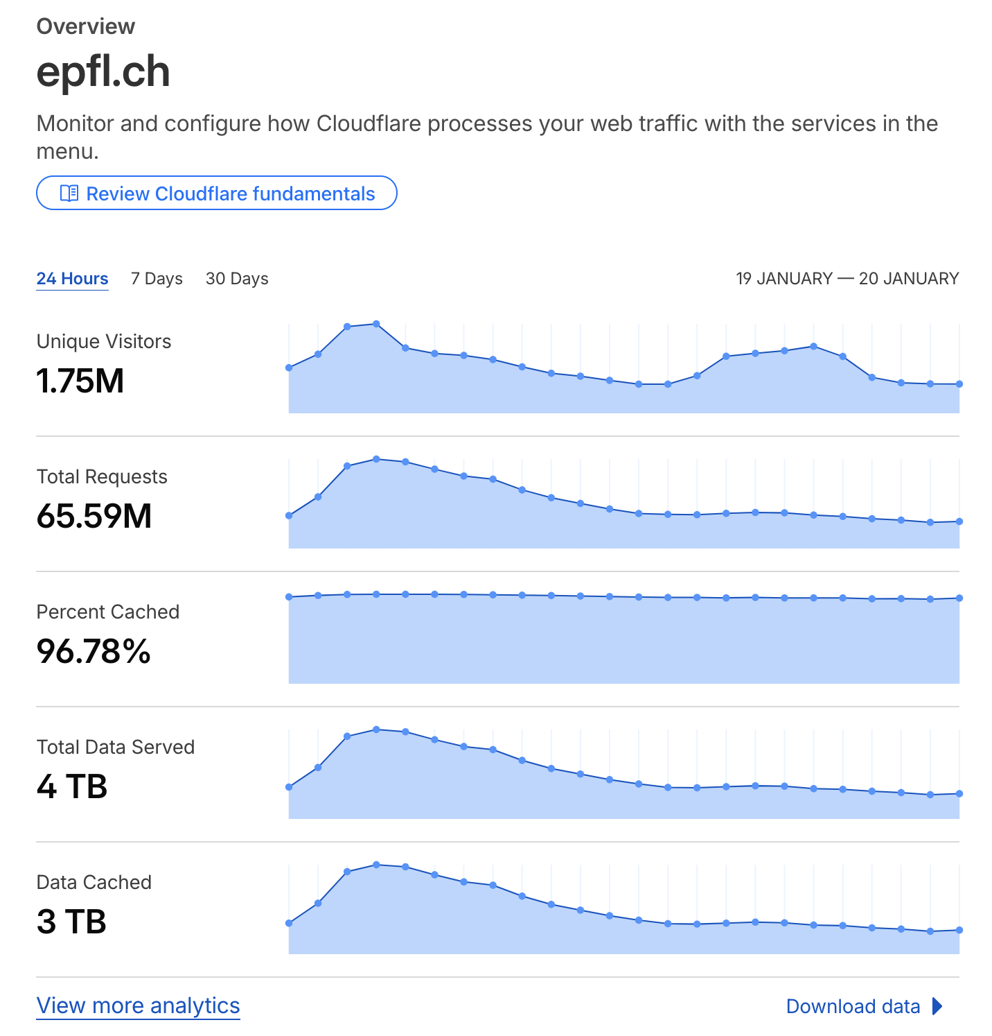
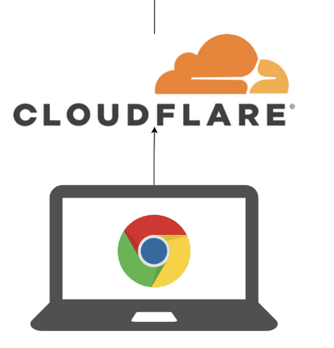
Edge cache
It protecs!
It attacs serves captchas!
It pays for itself in sheer bandwidth savings!
(Disclaimer: not affiliated with Cloudflare in any way, besides being satisfied customers of their service)
Notes:
Let’s put that out of the way: serving at scale pretty much requires procuring an edge cache.

Slide 9
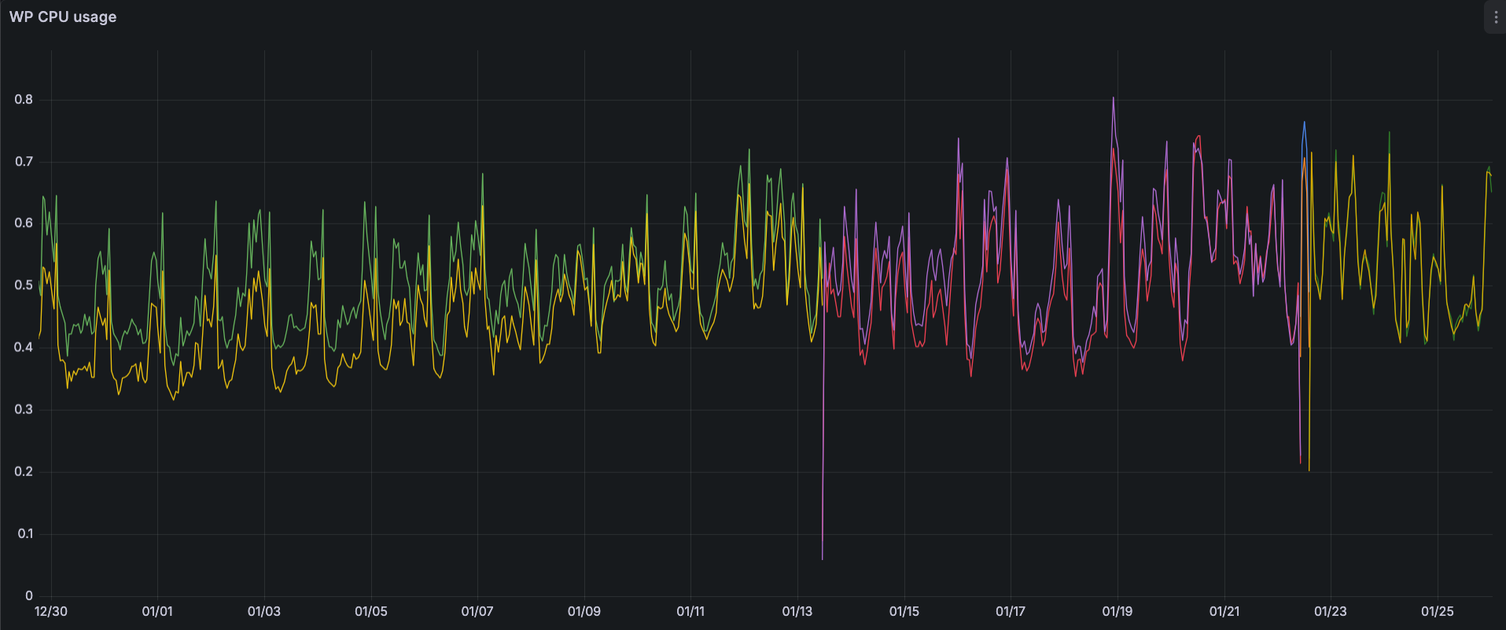
… How many pods?
Notes:
The limiting factor is CPU. As you can see, one pod could comfortably handle it all (although we have two for high-availability purposes)
https://grafana-prod-route-grafana-prod.apps.ocpitsp0001.xaas.epfl.ch/d-solo/wpngrfndshbrda/e29cb0-wpn-e29cb0?orgId=1&from=2025-12-29T17:33:57.856Z&to=2026-01-28T17:33:57.856Z&timezone=browser&refresh=30s&panelId=15&__feature.dashboardSceneSolo=true

Slide 10
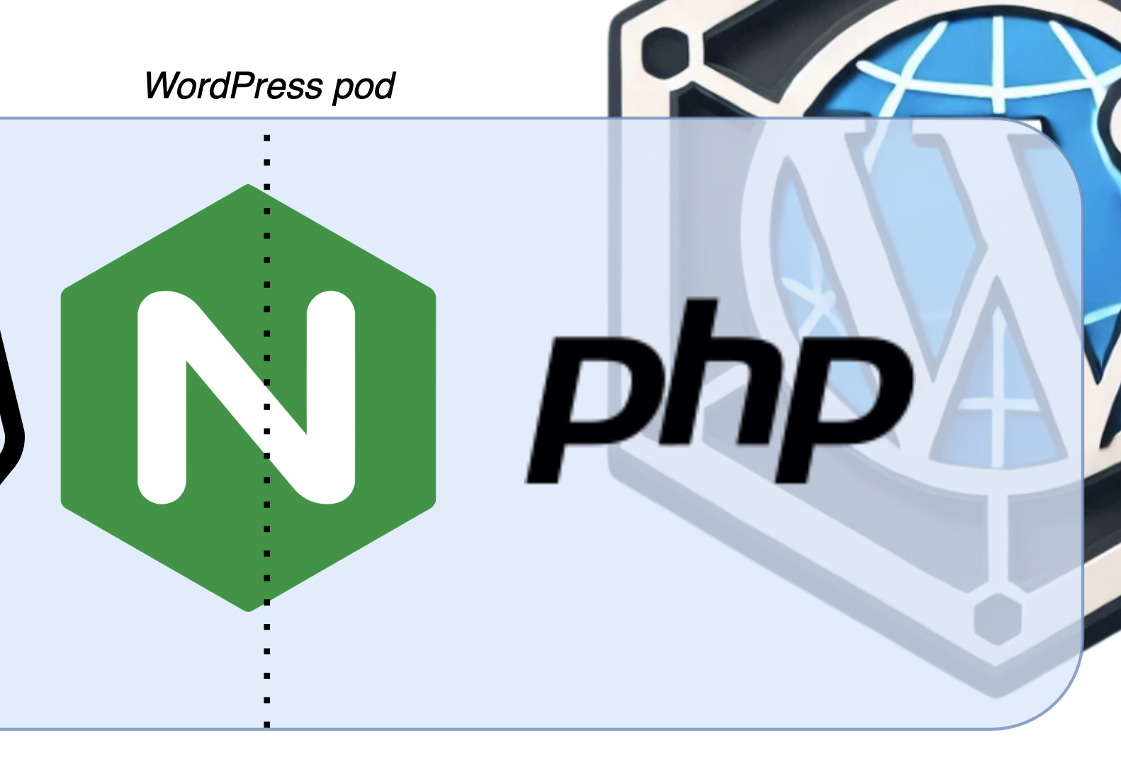
WordPress in a container two containers
Apache → nginx: non-blocking Web server
php-fpm: same pod, separate container
ships w/ immutable PHP code
👍
  Security: hard to backdoor
  Performance: kernel FS cache
  ≈ µs latency
We used to require another layer of cache on-premise (varnish). We no longer do.
Notes:
This is a zoom on the serving container from the pic 2 slides ago.
Nginx; not Caddy and (hence) not FrankenPHP, yet

Slide 11
nginx is boss 👑
knows 🧠
about all sites, all URLs, all filename patterns, and all WordPress 12-factored variables
(i.e. MariaDB credentials)
serves 🧑‍🍳
static files out of
  The container image
  or NFS again (just for uploads now 😉)
passes 🏈
the query to php-fpm for interactively rendered content
Each WordPress request is served independently from the others.
Notes:
[passes 🏈] through a UNIX domain socket, meaning that PHP doesn’t see the nginx.conf
Passes along with “FastCGI vars”, i.e; the 12-factored variables for that particular query only #needtoknow #security

Slide 12
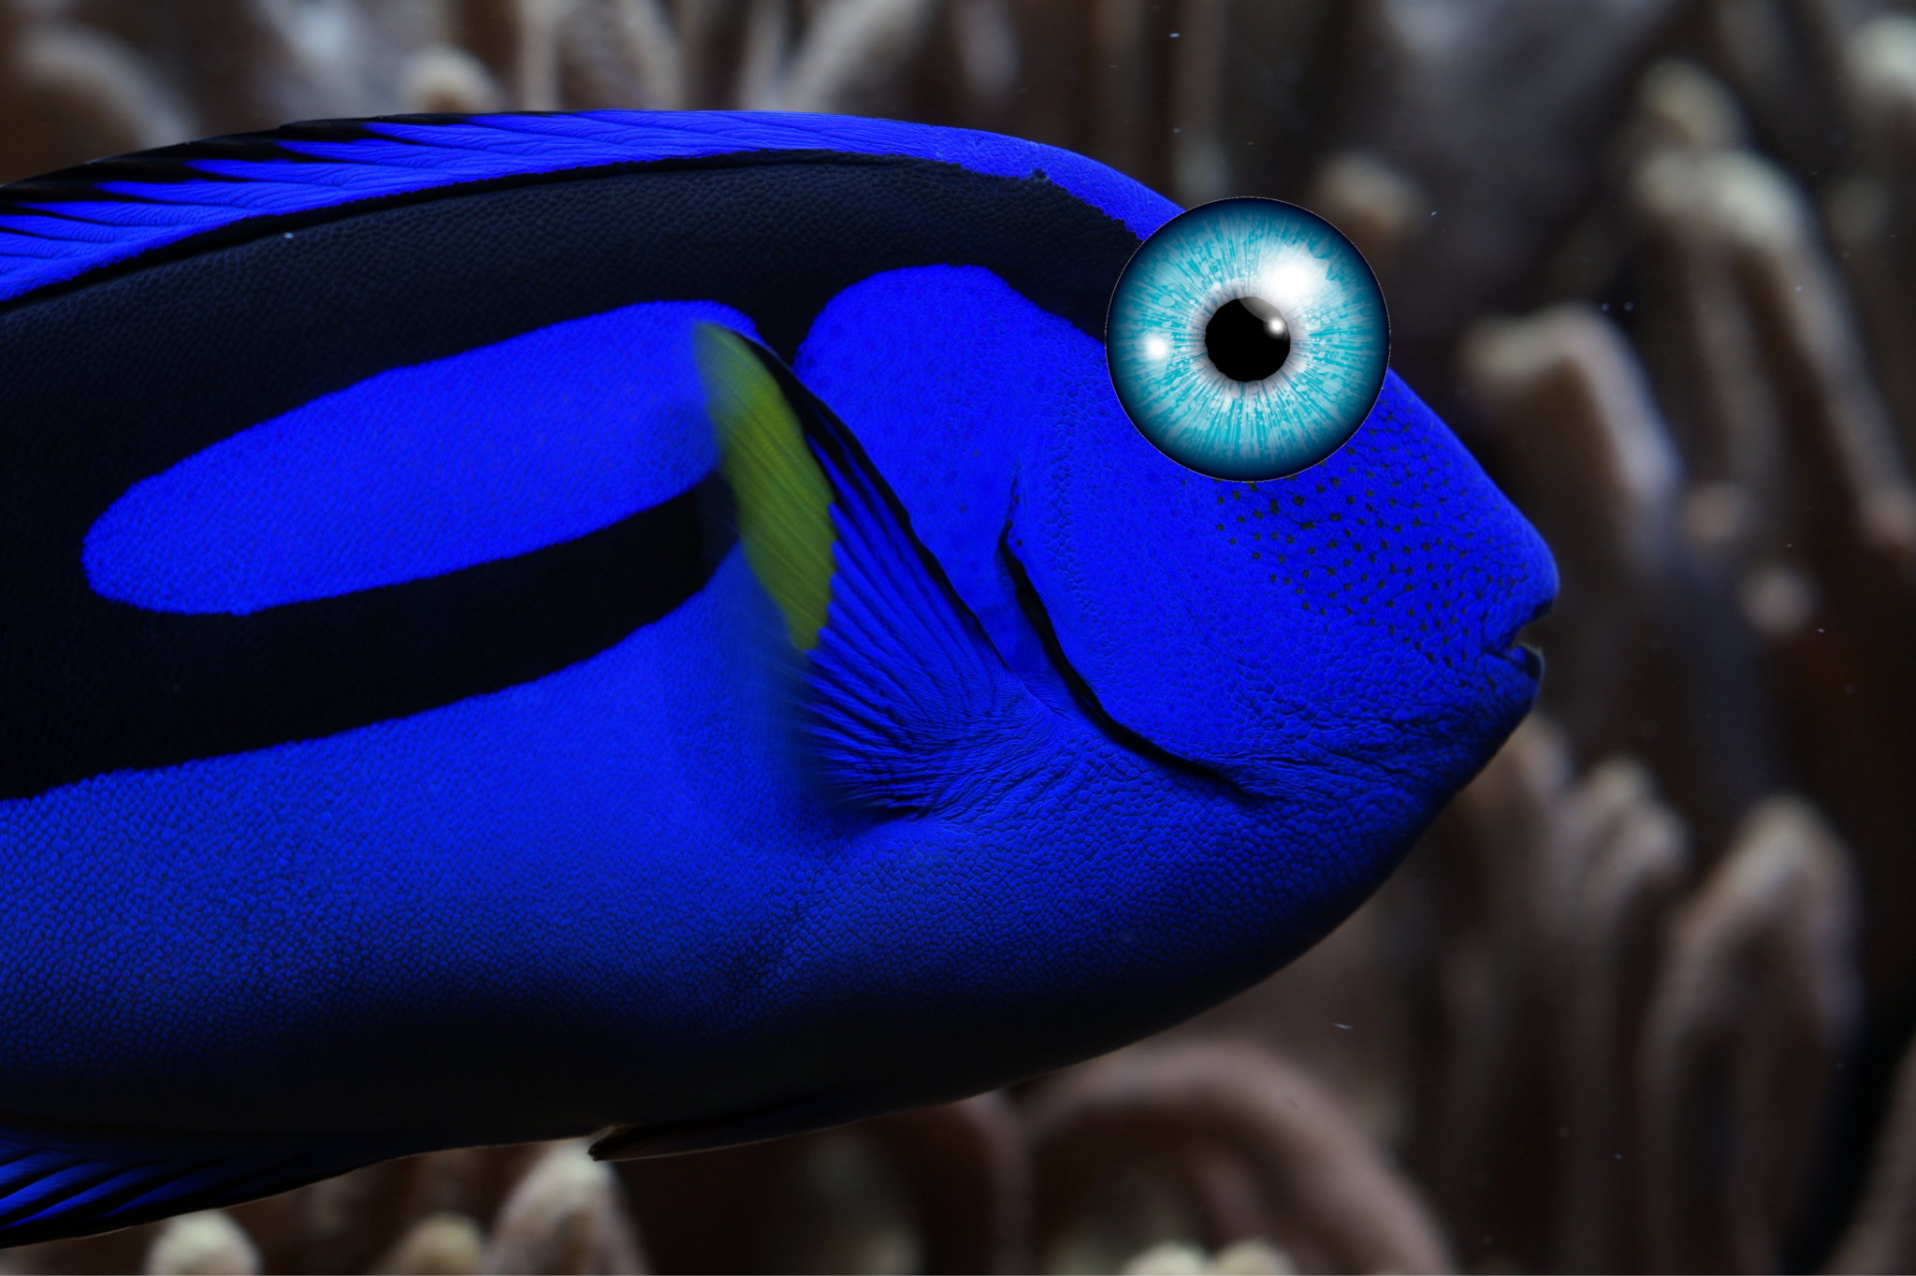
PHP?...
A design oversight turned killer feature:
forget everything, every time.
PHP / WordPress starts over from a blank slate upon each and every request.
Efficient? How?... 🤔
  “shared memory”
  “Zend cache”
Notes:
[blank slate] for all its initialization, configuration, global variables, database queries etc.
[Efficient? How?🤷‍♂️] How is that made efficient? I’m honestly not sure… It involves things called…
[”Zend cache”] Fast revalidation of that cache is crucial, as we saw.
- - -
PHP (under our nginx-based rig) is able to serve any two consecutive requests indifferently out of any WordPresses in the fleet — Without WordPress or its authors knowing or caring about that trick; i.e.
Transparent, massive virtual hosting,
without the “O(n) RAM” (or pods) part.
… or to put it differently,

Slide 13
PHP?...
We are effectively
turning the whole WordPress
into a function-as-a-service.

Slide 14
Serving at scale
> Operating at Scale
Developing at scale*
Using Kubernetes to the best of its capabilities
Absorbing complexity with the WordPress operator
Notes:
[Using Kubernetes to the best of its] self-operating, self-healing, auto-scaling, monitoring, and alerting [capabilities]

Slide 15
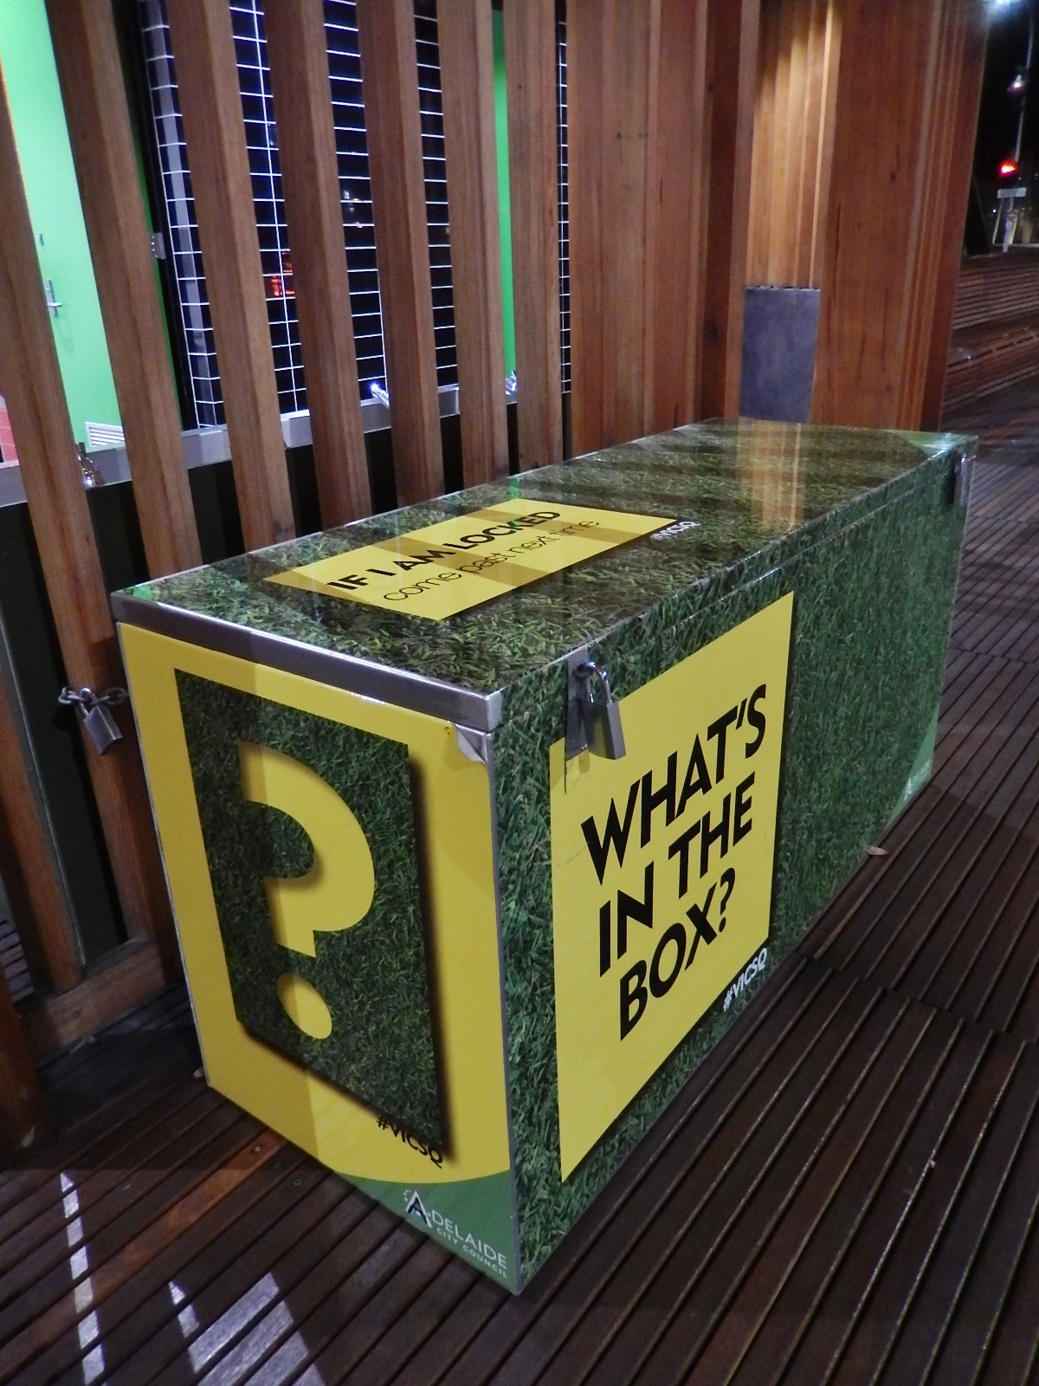
The operator is a program
… that operates in your stead.
In goes: 1× WordpressSite Kubernetes object
Out comes your site… kind of piecemeal:
  1× Ingress # of a “private” IngressClass; more on this later
  1× Route # or sometimes 0×, e.g. www
  1× Database # 🏈 to MariaDB operator
  1× mkdir() on NFS # uploads
  Homemade PHP code that
    Initializes the site
    Initializes or reconciles plug-ins and themes
All of that is made
With Python and Kopf, the Kubernetes Operator Framework
In a fully EPFL-agnostic way!
→ #coreplugindesign
Notes:
Be sure to move to next slide before engaging demo

Slide 16
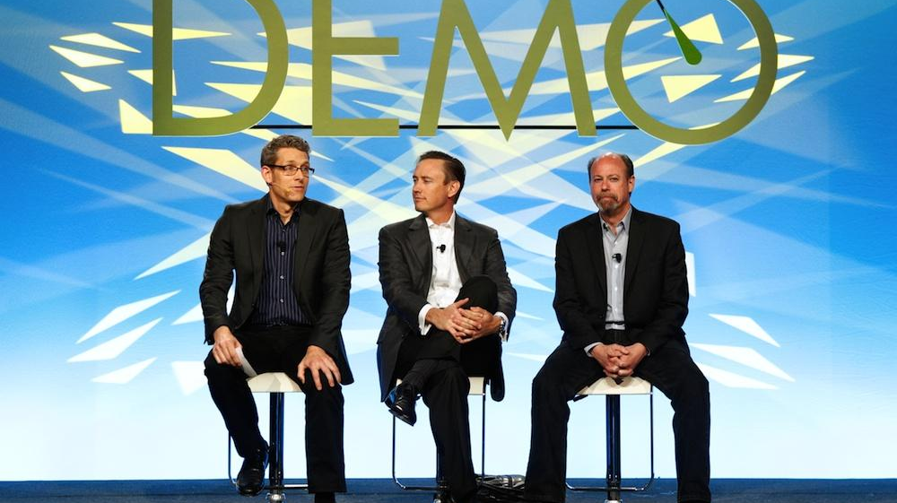

Slide 17
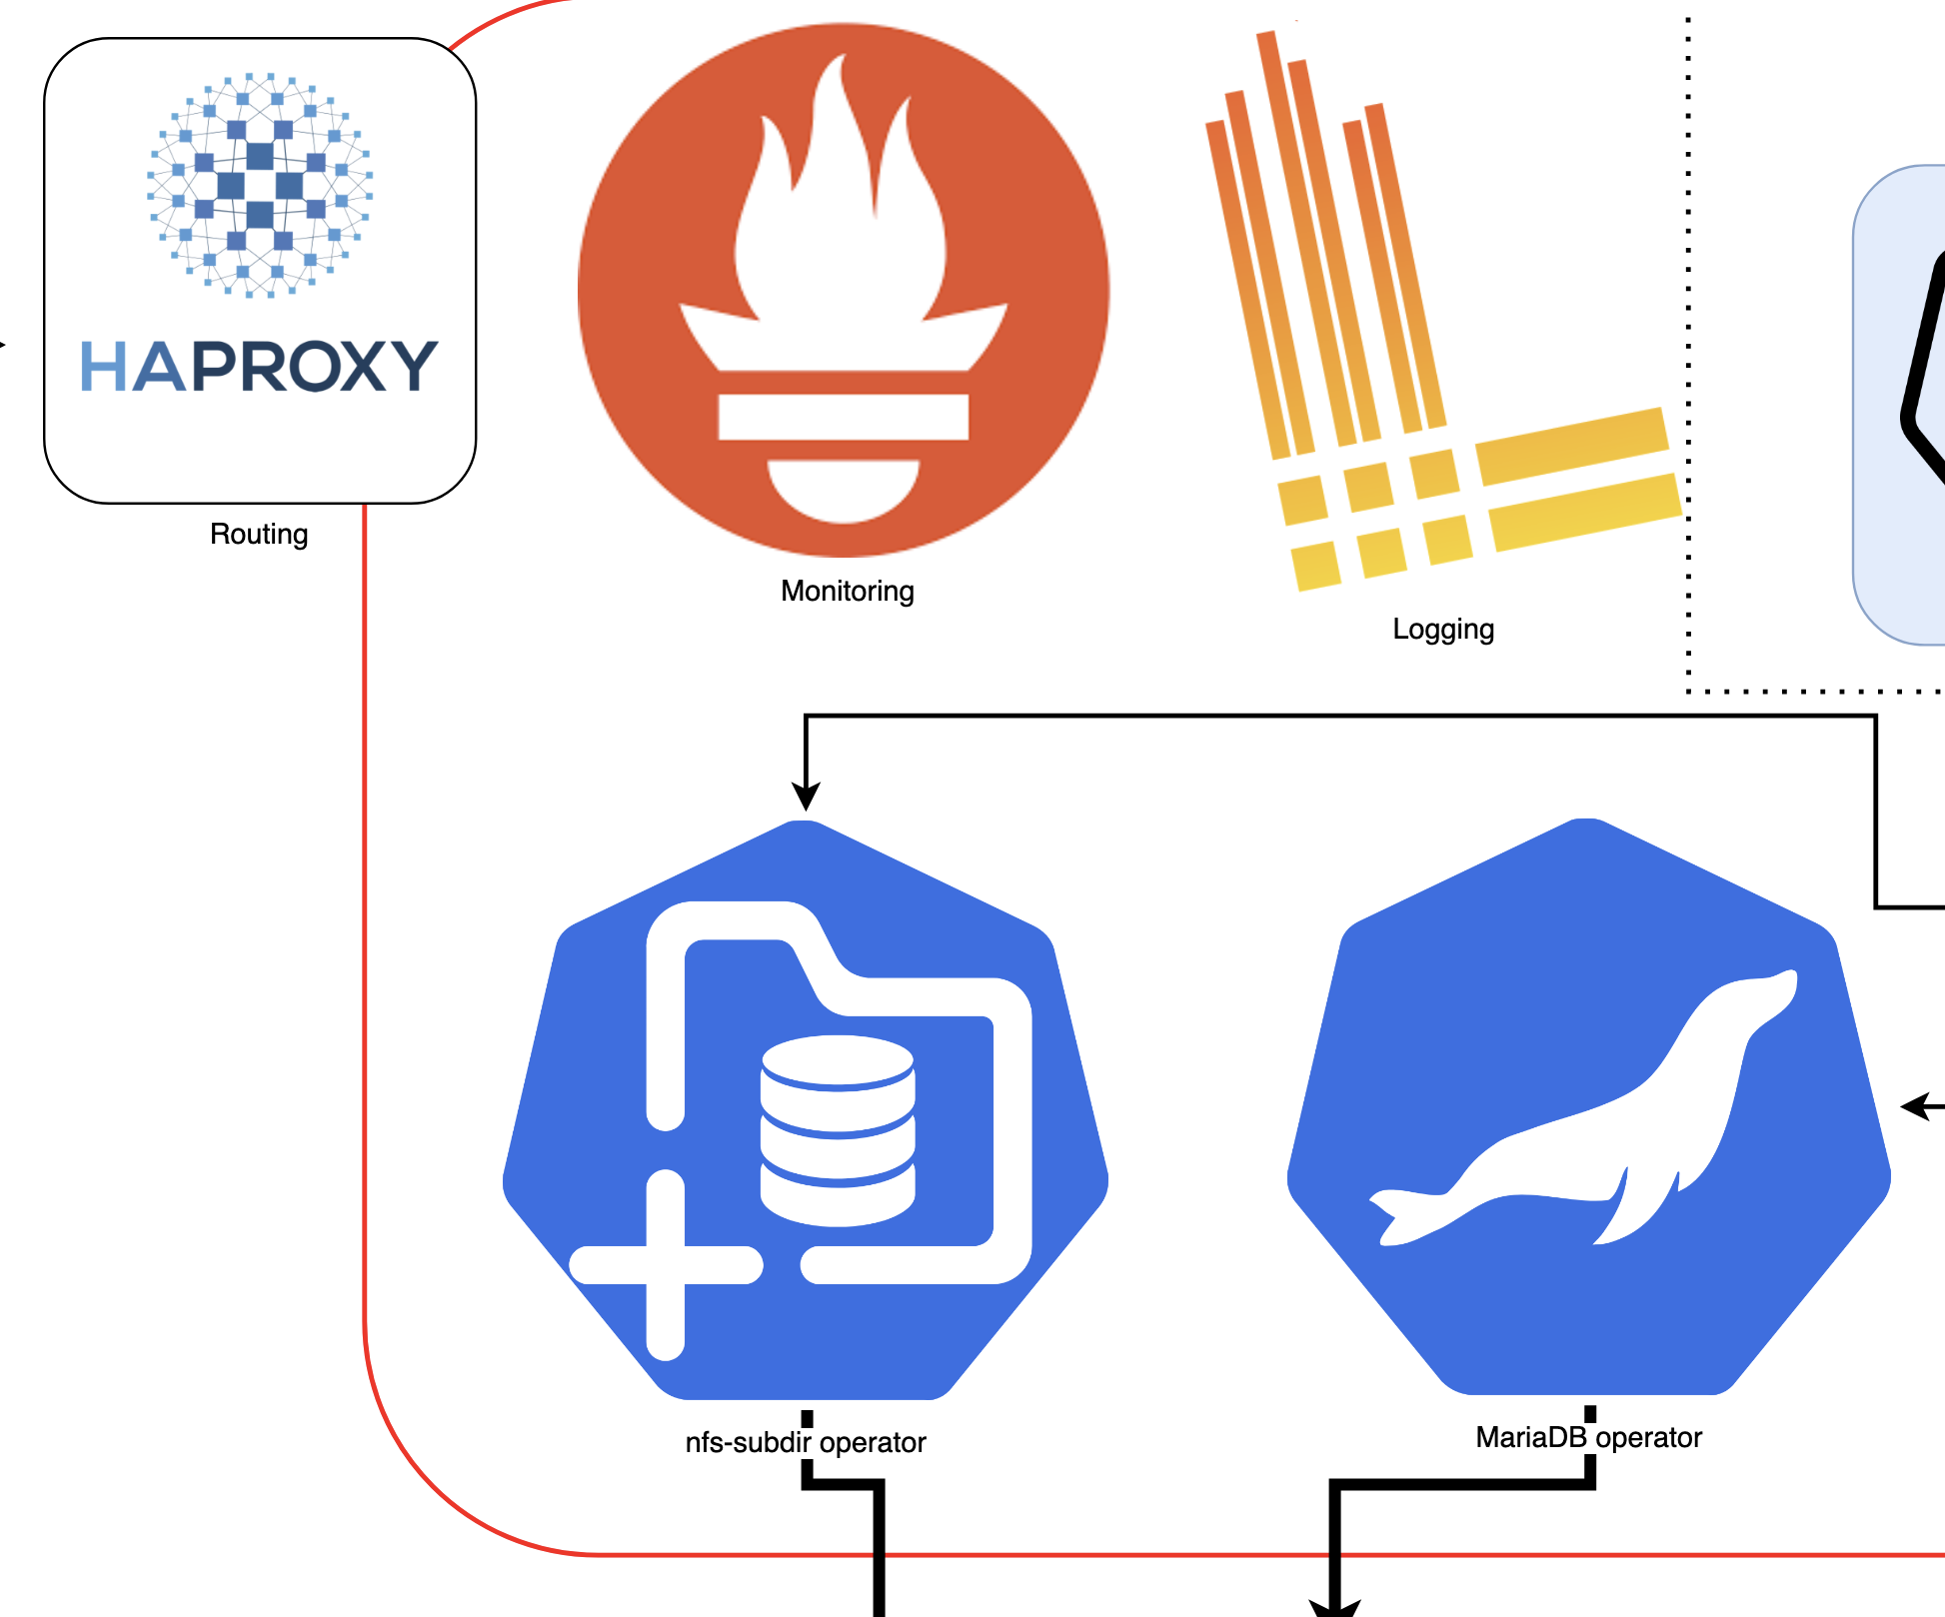
What needs doing on a daily basis?
Well… Not a whole lot.
We wrote wp-veritas (in Next.JS) for our Webgrandmaster to edit WordpressSite objects on their own
  That app captures a lot of EPFL-specific “business logic”…
  The rest being in our lineup of themes and plugins

Slide 18
What needs doing on a daily basis?
Well… Not a whole lot.
Backups to our on-premise S3 are being performed by the MariaDB operator
  Our own WP operator can optionally restore a site from there, under the same URL or a new one

Slide 19

… nightly basis?
We moved wp-cron into its own Kubernetes CronJob.
(Solved the 22h22 problem.)
We use that to monitor “slow” metrics into a Prometheus pushgateway: → plugin
Notes:
The original wp-cron design is… kind of 2000sy in a weird way. Basically it piggy-backs batch tasks against the (assumed continuous) flow of interactive traffic. We didn’t want that (it caused a “22h22 bug”).

Slide 20
Developing at (some) Scale
There’s 13 of us... But we’d welcome more! 😉

Slide 21
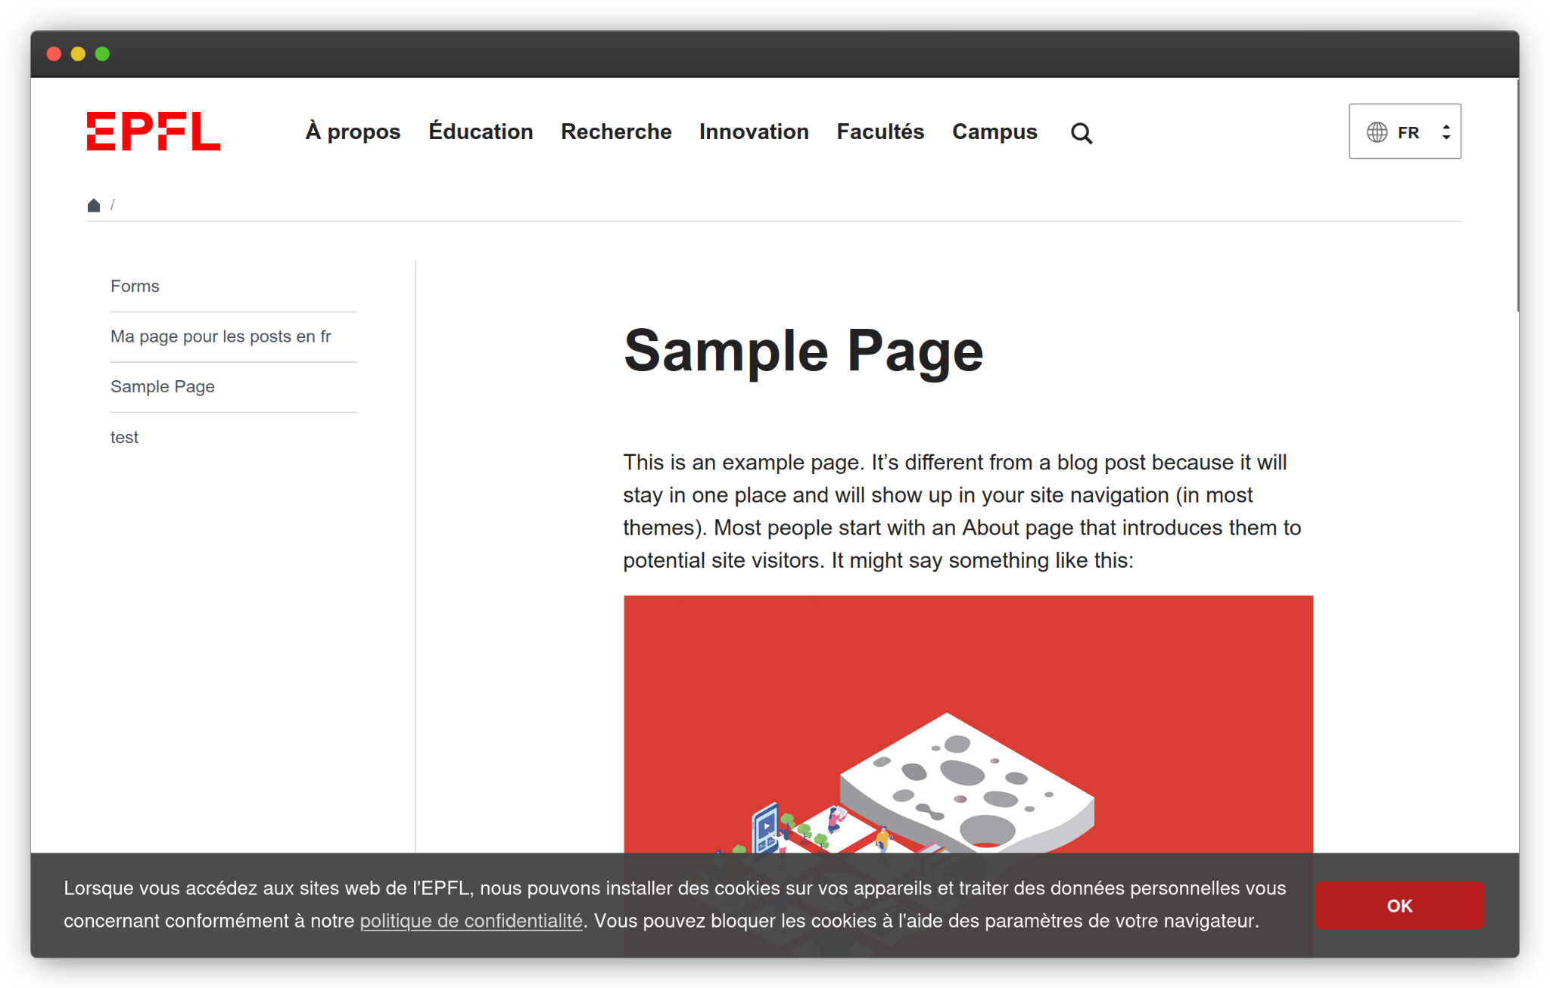
wp-dev: jump right in!
git clone https://github.com/epfl-si/wp-dev
cd wp-dev; make up
https://wordpress.localhost/ →
Notes:
What comes in the box: docker-compose, PHP in mounted volumes, fully operational Git repositories ready to commit and (for the team) push.

Slide 22




Conclusion:
Ready for immediate consumption?
WP-Operator
Dockerfiles
EPFL theme
Plug-ins: from
… to
WP-dev
WP-Veritas
Flagship contribution
Coupled with Ansible 🤷‍♂️
e.g. lunch menus
e.g. pushgateway
Notes:
Dockerfiles capture our performance-related contributions: the nginx + controller rig (required for interop with the operator); and the wp-cron offload. They have some minimalistic amount of plug-in nature. We would gladly consider moving them to separate repositories, for people who don’t want Ansible.

Slide 23
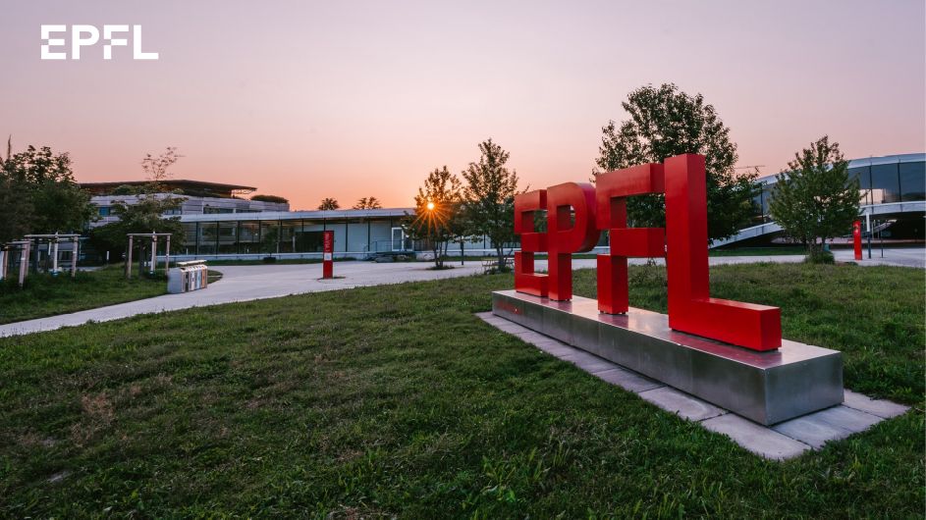
Thanks for attending!
… Please get in touch!
isas-fsd@groupes.epfl.ch
#2026-containers:fosdem.org
Notes:
REPEAT the question(s)

Slide 24
Future plans
Instrumented PHP → OTel
More documentation

Slide 25
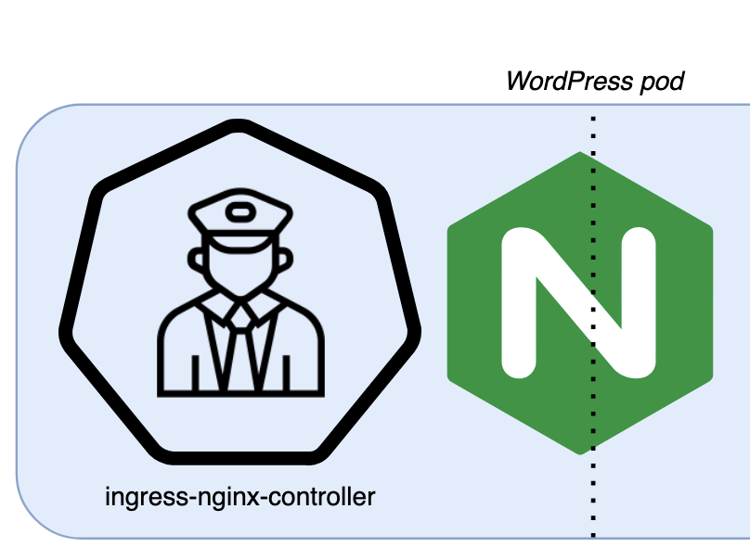
The nginx ingress controller is another program
… that controls nginx, based on Ingress objects in Kubernetes.
In comes: a whole bunch of Ingresses, that the WordPress operator created (as seen previously);
Out comes: the nginx configuration file.
We took this one “as-is” from github.com/kubernetes/ingress-nginx (and substituted our own golang template)
Notes:
Let’s go back to the demo and see our newly created Ingress.
I apologize if I look like I’m fawning over nginx, which I hear fell out of favor lately. (I’m getting old 🤷‍♂️) But this is the part where we are not sure that a “modern” approach (i.e. FrankenPHP) would have a hard time providing us with as much convenience. #patcheswelcome obviously

Slide 26
Photo Credits
"Baby facepalm" by bigpresh is licensed under CC BY 2.0.
"Blue tang fish close up" and "Realistic blue eye clip art" are marked with CC0 1.0 both.
"Mystery Box" by mikecogh is licensed under CC BY-SA 2.0.
"AARP DEMO" by jurvetson is licensed under CC BY 2.0.
"Nightly Glow / Nikon D600" by Gino Andenmatten | Photography is licensed under CC BY-NC-ND 2.0.
EPFL branding, logo, slideware, photos and clip art used with permission.
All product logos belong to their respective owners.
I’m… honestly not entirely sure about the copyright status of that picture of my younger self; scanned from my own, expired carte d’identité? 🤷‍♂️ I’m going with the #deminimisnoncuratprætor defense

